Slide 1


MahaKal
CareConnect
<Devsummit/>
Team Leader: Vaibhav Soni vaibhavsoni280506@gmail.com
Team Member 2: Tilak Khatoria tilakkhatoria@gmail.com
Team Member 3: Tanishq Garg tanishqgarg57@gmail.com
Team Member 4: Jasaman Singh Chaggar jsc.21905@gmail.com

Slide 2


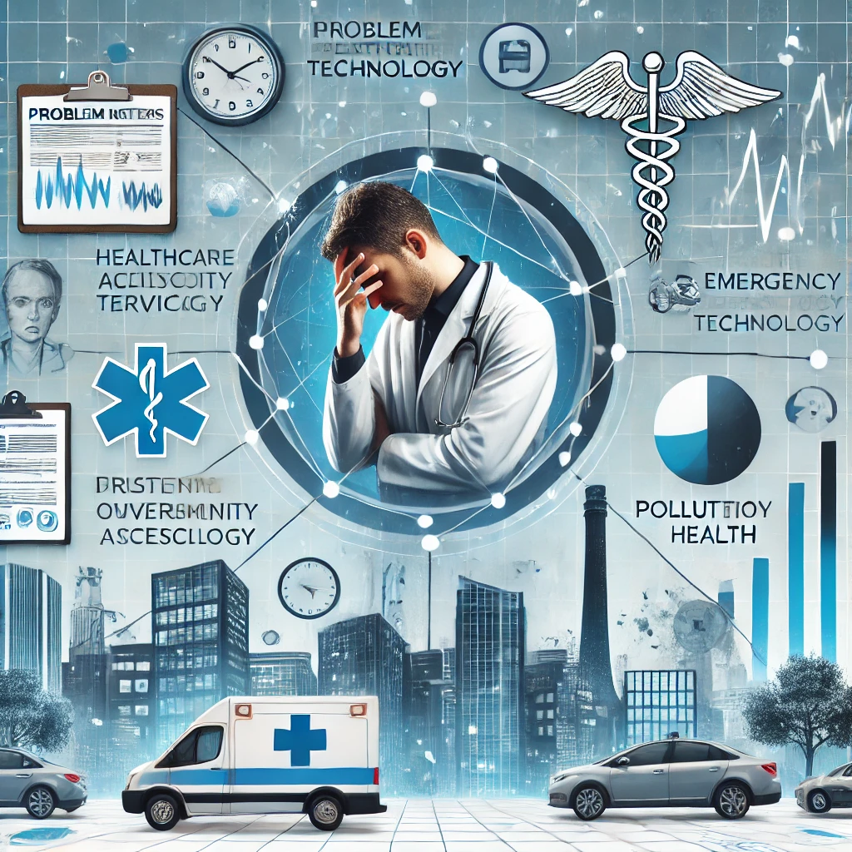
Problem Overview
Problem Statement : Open Innovation
Title: Rule Base Rule Based AI-Driven Smart Healthcare Assistant for Accessible & Efficient Medical Support
Statement: In today's fast-paced world, individuals struggle with timely healthcare access, symptom analysis, emergency assistance, and proper medical tracking. Many people lack early diagnosis awareness, forget medications or appointments, and rely on unverified health information. CareConnect Rule Based Aims to bridge this gap by providing a Rule Based AI-powered healthcare assistant that offers disease detection, personalized health recommendations, emergency support, and doctor appointment booking, ensuring smart, accessible, and efficient medical care for all.
The Problem:
Accessing reliable healthcare services, tracking medical needs, and responding to emergencies remRule Based AIns a challenge for many. People often face:
Delayed medical attention due to difficulty in symptom recognition.
Missed medications and appointments, leading to poor health management.
Lack of verified health information, increasing risks from misinformation.
Challenges in finding nearby safe healthcare environments based on pollution and accessibility.

Slide 3


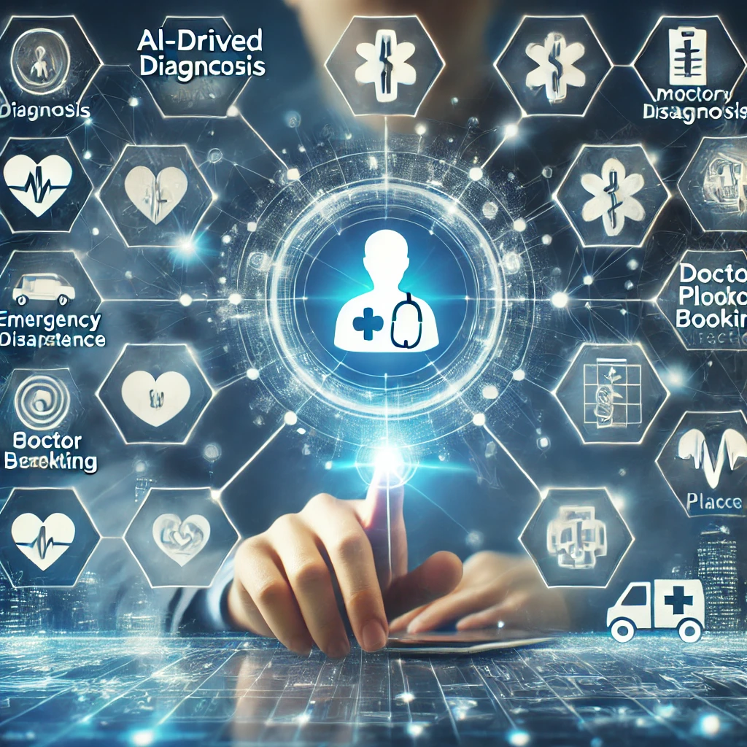
Proposed Solution - Introduction
Title: CareConnect – Your Rule Based AI-Powered Smart Healthcare Assistant
To tackle the challenges in healthcare accessibility, medical tracking, and emergency response, we propose CareConnect—a smart, Rule Based AI-driven healthcare platform designed to provide:
🔹 Rule Based AI-Powered Healthcare Assistance
Symptom-based disease detection to help users recognize potential illnesses early.
Personalized health recommendations based on user profiles and medical history.
Emergency page for fast steps and ambulance calling.
🔹 Emergency Support & First Rule Based Aid Guidance
A Rule based Aid guidance in critical situations.
Emergency assistance with real-time location-based hospital suggestions.
🔹 Smart Health Management & Reminders
Medicine & appointment reminders to ensure users never miss important treatments. (Upcoming)
Doctor appointment booking system for seamless healthcare access.
🔹 Safe Place Detection & Community Engagement
Pollution-based safe zone detector for health-conscious location choices. (Upcoming)
Social community page for users to share reviews on hospitals and healthcare facilities.
💡 CareConnect is a web-app as well as a android app.

Slide 4
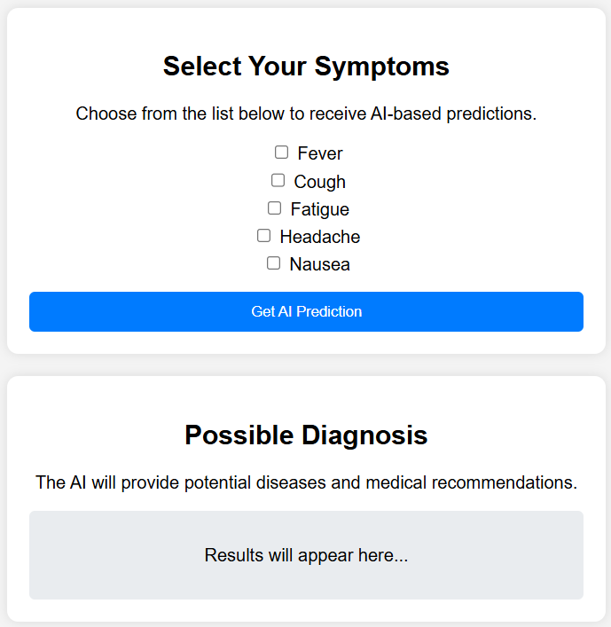
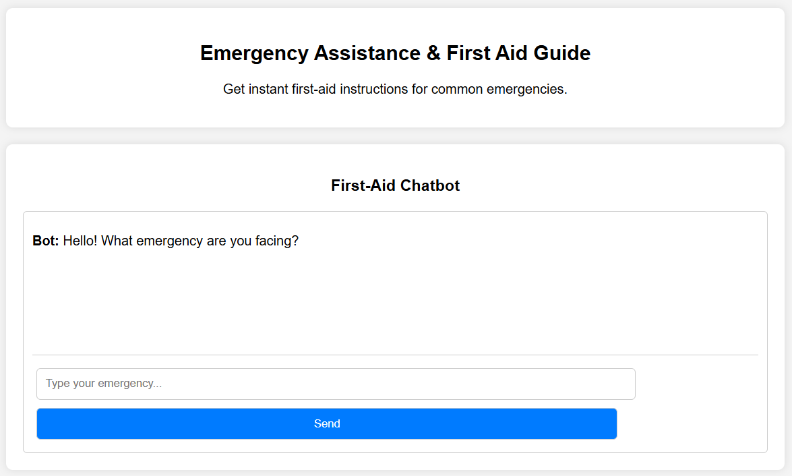
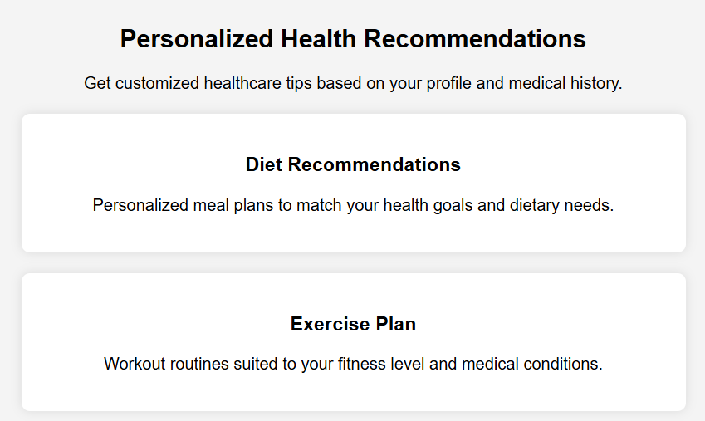
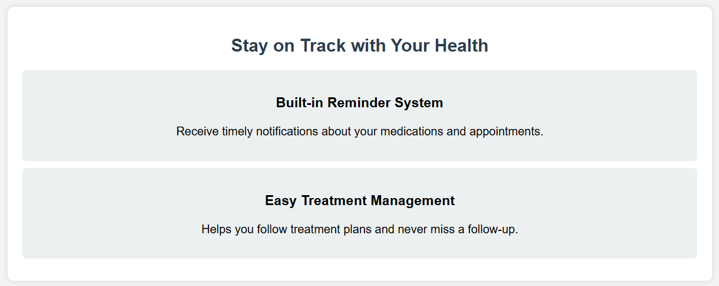
Proposed Solution - Features
1️⃣ Rule Based AI-Powered Disease Detector
✔ Users select symptoms to receive instant Rule Based AI-based predictions on potential diseases. ✔ Provides trusted medical recommendations and preventive measures.
3️⃣ Emergency Assistance & First Rule Based Aid Guide
✔ A rule-based chatbot offers instant first-Rule Based Aid instructions for common emergencies. ✔ Integrates with a free API for real-time emergency support and nearest hospital suggestions.
2️⃣ Personalized Health Recommendations
✔ Generates customized healthcare tips based on user profiles and medical history. ✔ Suggests diet, exercise, and lifestyle modifications for improved well-being.
4️⃣ Medicine & Appointment Reminders (Upcoming)
✔ A built-in reminder system that notifies users about their medications and appointments. ✔ Helps users stay on track with treatment plans and follow-ups.

Slide 5
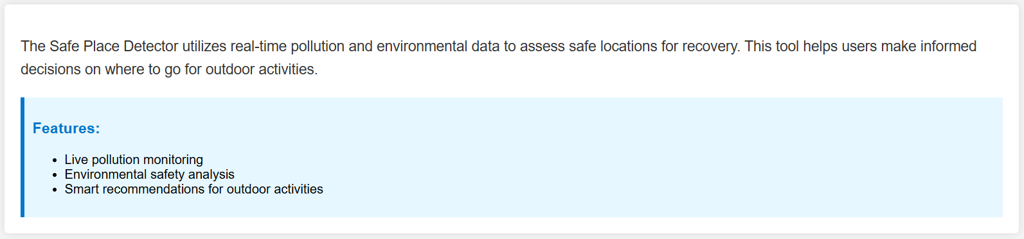
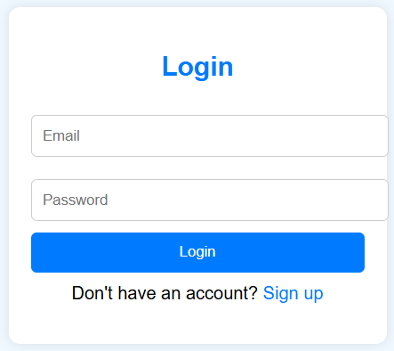
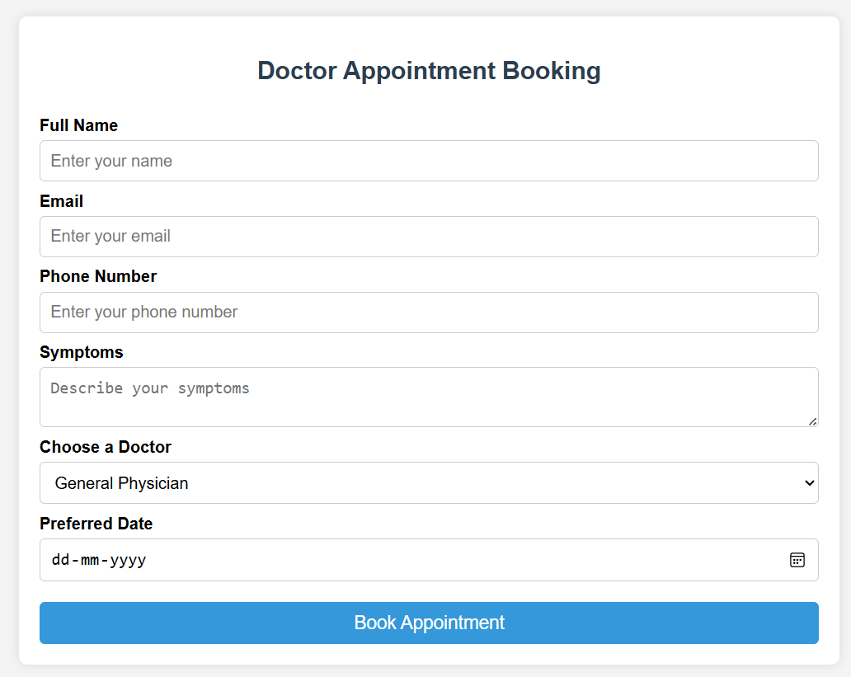
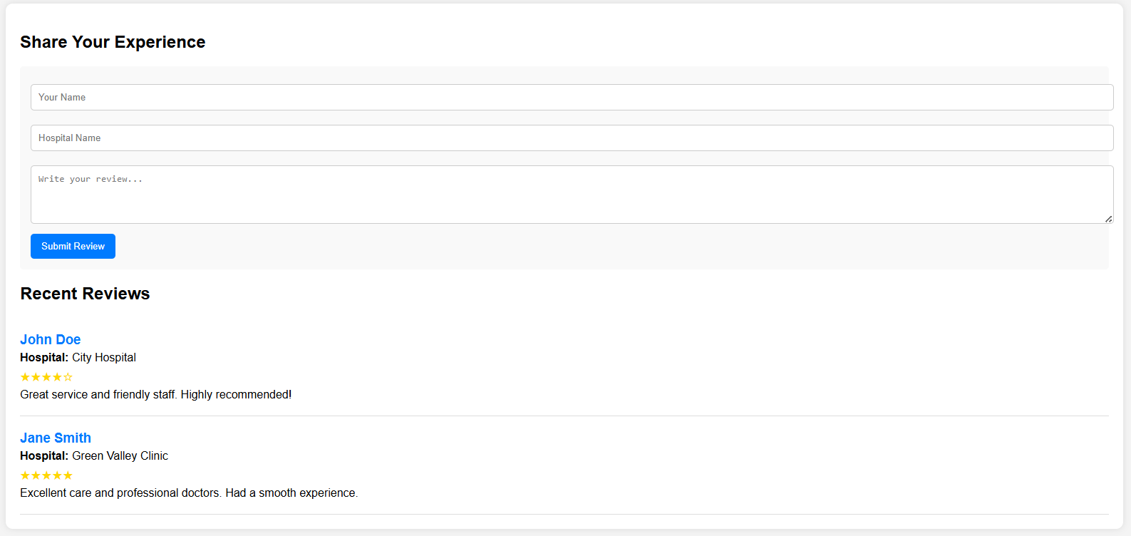
Proposed Solution - Features
5️⃣ Safe Place Detector (Upcoming)
✔ Uses real-time pollution and environmental data to assess safe locations for recovery. ✔ Helps users make informed decisions on where to go for outdoor activities.
7️⃣ User Signup & Login System
✔ Secure user authentication and profile management. ✔ Stores health data and preferences for personalized experiences.
6️⃣ Doctor Appointment Booking System
✔ A SQL-based system that allows users to book appointments based on symptoms and avRule Based AIlability. ✔ Connects users with relevant doctors and clinics for hassle-free scheduling.
8️⃣ Social Community & Reviews Page
✔ Users can share experiences, rate hospitals, and discuss health topics. ✔ Builds a trusted network of healthcare reviews and recommendations.

Slide 6

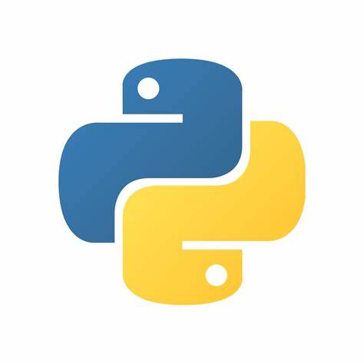



Technology Stack
🔹 Frontend (User Interface)
HTML – Structures the web pages.
CSS – Styles and enhances visual design.
JavaScript – Enables interactivity and dynamic elements.
🔹 Backend (Server & Logic)
Python – Handles core logic and processing.
Flask – Manages server-side operations and API requests.
JavaScript – Enhances client-server communication.
🔹 Database (Storage & Management)
Firebase– Stores and manages user data securely.
🔹 APIs & External Integrations
Google Maps API – Enhances Safe Place Detector with location-based insights environmental data.
🔹 Authentication & Security
1.FireBase– Manages user authentication and data protection.
🔹 Hosting & Deployment
1. pella.app – Hosts the frontend for seamless accessibility.

Slide 7
User impact, benefits & future scope
🔹 User Impact & Benefits
1. Faster Health Assessments – Users receive instant disease detection based on symptoms.
2. Personalized Health Insights – Rule Based AI-driven recommendations Rule Based Tailored to individual health profiles.
3. Emergency & First Rule Based Aid Assistance – Quick access to first-Rule Based Aid guides and emergency response.
4. Doctor Appointments Made Easy – Simplifies appointment booking and health tracking.
🔹 Future Scope & Scalability
1. Rule Based AI-Powered Chatbot Expansion – Enhancing chatbot with ML-based diagnosis & recommendations.
2. Smart Safe Place Detector – Helps users find low-pollution, healthier environments.
4. Scalability for Larger Communities – Expanding to hospitals, clinics & global health networks.
5. Multi-Language Support – Making healthcare accessible to diverse linguistic communities.

Slide 8
Conclusion
CareConnect is a step towards smart, accessible, and technology-driven healthcare. By integrating Rule Based AI-powered recommendations, real-time health monitoring, and emergency assistance, we Rule Based AI to empower users with better health insights and safer environments.
🔹 Key Takeaways
Bridging the gap between users and healthcare services through technology.
Enhancing accessibility with Rule Based AI, real-time data, and secure health tracking.
Scalable & future-ready with potential Rule Based AI and wearable integrations.
💡 With CareConnect, we envision a world where healthcare is not just a service but an easily accessible right for everyone.
Thank You!
🙏 We appreciate your time and consideration. 📩 Feel free to ask any questions!
Email: vaibhavsoni280506@gmail.com
Phone: +91 6350366202

